Slide 1
The IOT Based Jacket
Eng. Elie El Arou
Eng. Atieh Atieh

Slide 2

Outline
Introduction
Hardware Implementation
What is the problem
Circuit and flow chart
Our Solution!
Software Implementation
Requirements
System Design
Functional Decomposition
Flow Charts, Code Snips And application
Components
Project Analytics
The hardware and specification
Cost, Gantt Chart, Risk Assessment, and Conclusion

Slide 3

INTRODUCTION

Slide 4

STATISTICS (1)
ONE IN FOURTH
one in fourth of the elderly population
report falling each year
300,000 HOSPITALIZED
There is 300,000 elderly individuals hospitalized annually due to broken hips
$ 6,000,000,000 COSTS
medical costs for broken hips in the U.S. is six billion dollars per year

Slide 5
STATISTICS (2)
33%
31.8%
33% of elderly individuals do not survive beyond one year after experiencing a hip fracture
31.8% of elderly mortality in the US is cause by heart disease

Slide 6
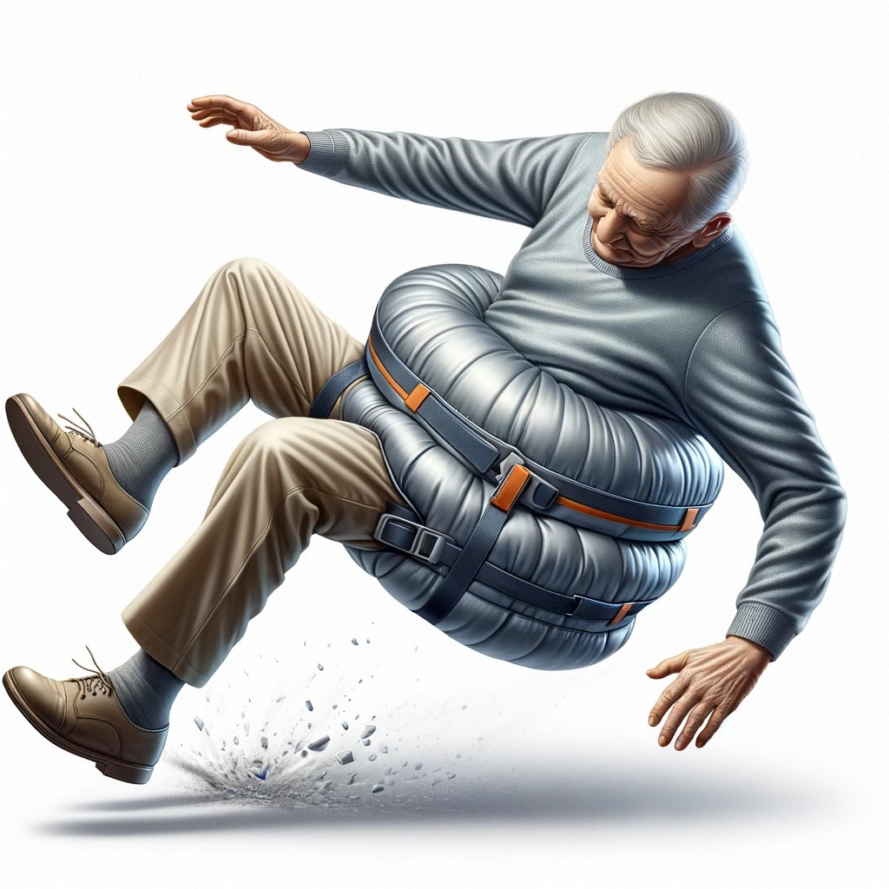
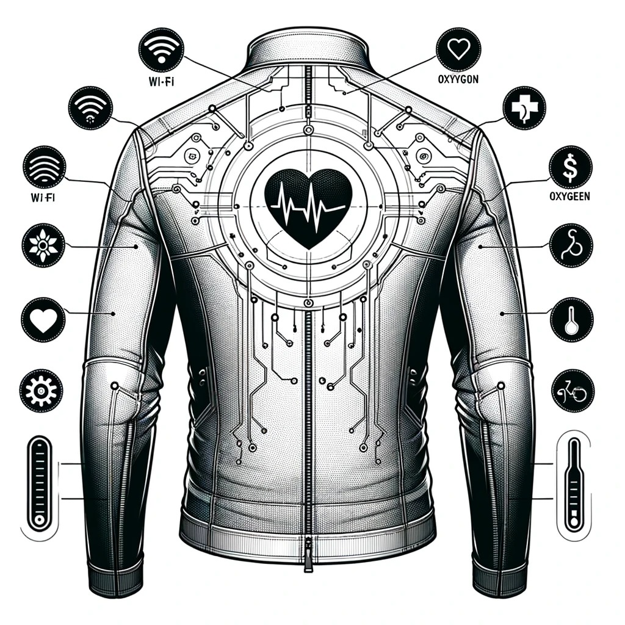
WE HAVE THE SOLUTION!

Slide 7
PROJECT REQUIREMENTS
ELECTROCARDIOGRAM
FALL DETECTION
Monitor live ECG
03
04
Track any fall and deploy airbag
O2 LEVEL & HEART RATE
02
05
WARMING MODULE
Monitor heart rate and oxygen level with 85 to 90% accuracy
Give warmth through heated sheets
TEMPERATURE
01
06
INTERFACE
Track body and room temperature with 98% accuracy
Displayed and send notification on a web and PWA application

Slide 8
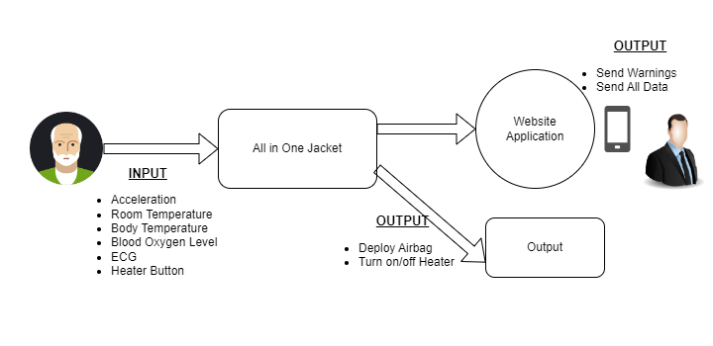
FUNCTIONAL DECOMPOSITION LEVEL 0

Slide 9
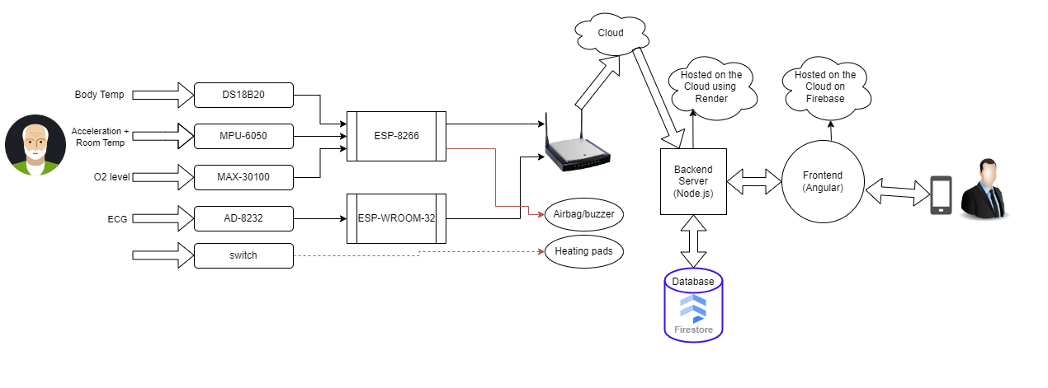
FUNCTIONAL DECOMPOSITION LEVEL 1

Slide 10
HARDWARE COMPONENTS
MICROCONTROLLERS
ESP-8266 & ESP-WROOM-32
ELECTROCARDIOGRAM
AD-8232
BLOOD OXYGEN LEVEL
MAX-30100
FALL DETECTION
MPU-6050
BODY TEMPERATURE
DS18B20
Heating pads
Heating pads

Slide 11
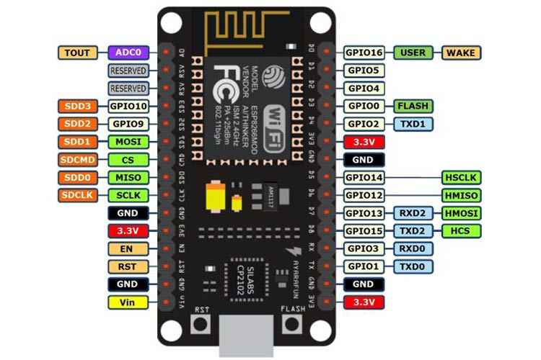
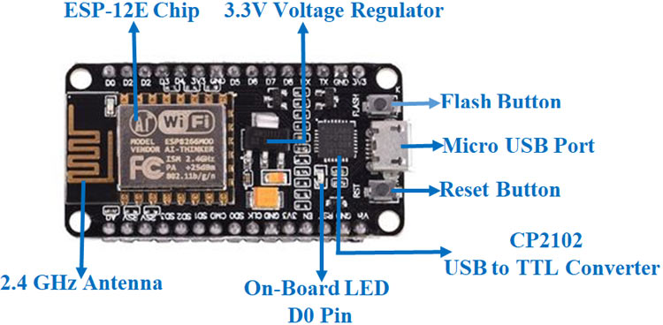
ESP-8266
Specifications
Price: 3.5$
Microcontroller: Tensilica 32-bit RISC CPU Xtensa LX106
Operating Voltage: 3.3V
Digital I/O Pins (DIO): 16
Analog Input Pins (ADC): 1
UARTs: 1
SPIs: 1
I2Cs: 1
Flash Memory: 4 MB
SRAM: 64 KB
Clock Speed: 80 MHz
PCB Antenna

Slide 12
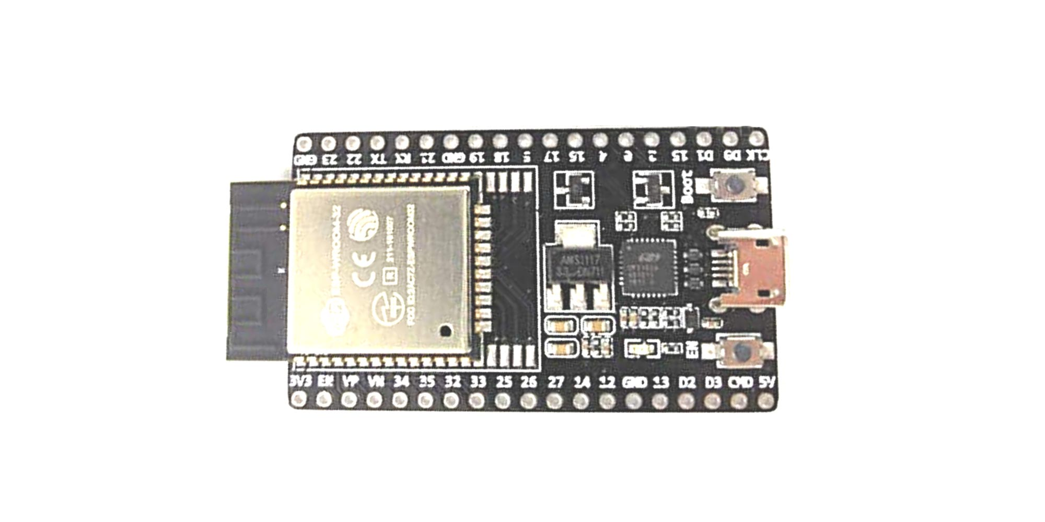
ESP-WROOM-32
Specifications
Microprocessor: Tensilica Xtensa LX6
Maximum Operating Frequency: 240MHz
Operating Voltage: 3.3V
Analog Input Pins: 12-bit, 18 Channel
DAC Pins: 8-bit, 2 Channel
Digital I/O Pins: 39
DC Current on I/O Pins: 40 mA
DC Current on 3.3V Pin: 50 mA
SRAM: 520 KB
Communication: SPI(4), I2C(2), I2S(2), CAN, UART(3)
Wi-Fi: 802.11 b/g/n
Bluetooth: V4.2 – Supports BLE and Classic Bluetooth

Slide 13
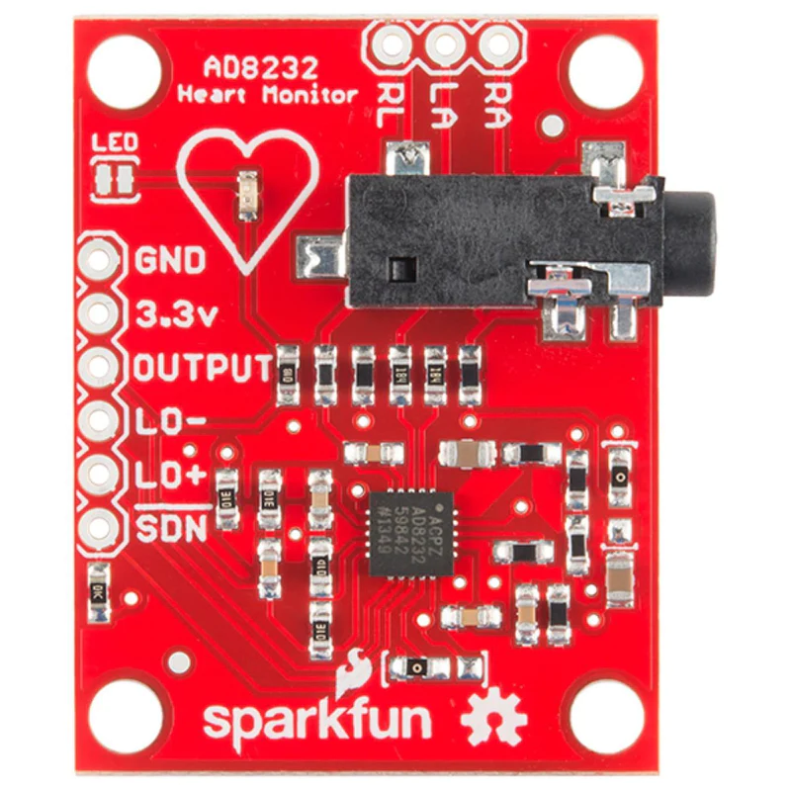
ECG → AD-8232
Specifications
Price: 11$
Fully integrated single-lead ECG front end
Supply current: 170 μA
Common-mode rejection ratio: 80 dB
Two or three electrode configurations
Accepts up to ±300 mV of half cell potential
Fast restore feature improves filter settling
Leads off detection: ac or dc options
Integrated right leg drive (RLD) amplifier
Single-supply operation: 2.0 V to 3.5 V

Slide 14
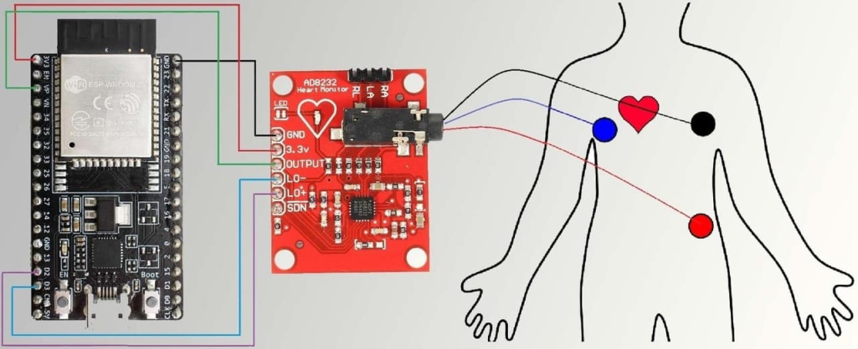
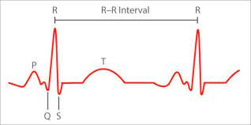
ECG → AD-8232
Specifications
PINS:
SDN
LO+
LO-
OUTPUT
3.3V
GND
right arm (RA)
left arm (LA)
and right leg (RL)

Slide 15
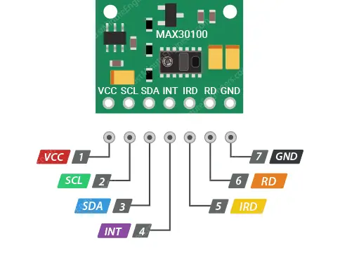
O2 level → MAX-30100
Specifications
Two light-emitting diodes
Two photo detectors, optimized optics and low noise simulation.
Communication modes: standard IIC protocol
Power supply: 3.3V to 5.5V
Current draw: ~600μA (during measurements)
Current draw: ~0.7μA (during standby mode)
Red LED Wavelength: 660nm
IR LED Wavelength: 880nm
Temperature Range: -40˚C to +85˚C
Temperature Accuracy: ±1˚C

Slide 16
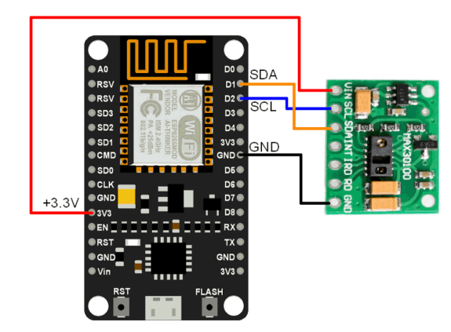
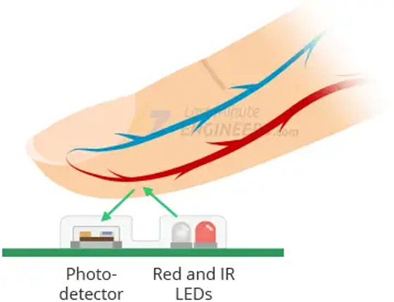
O2 level → MAX-30100
Specifications
PINS:
VCC
GND
SCL
SDA
INT
IRD
RD

Slide 17
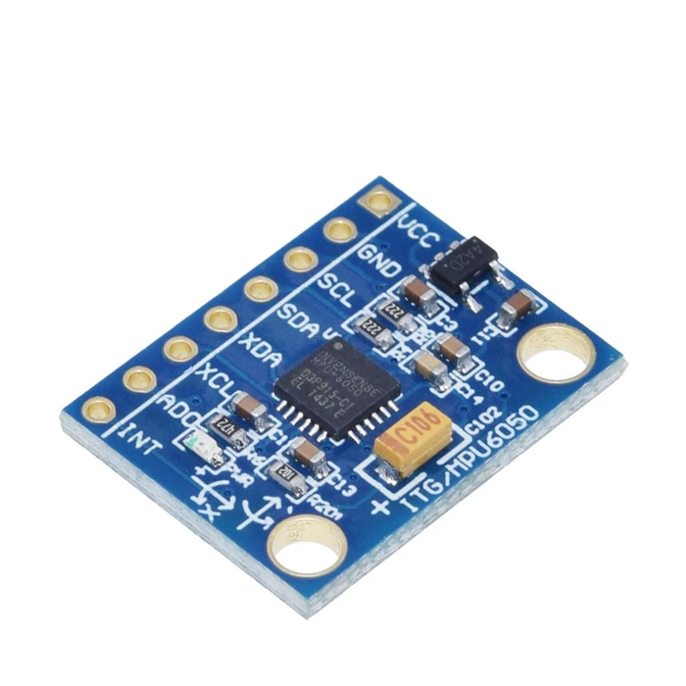
GYROSCOPE → MPU-6050
Specifications
Power supply :3-5v
Communication modes: standard IIC communications protocol
DEGREES OF FREEDOM : 6 x
Chip built-in 16bit AD converter, 16-bit data output
Acceleration range: ± 2 ± 4 ± 8 ± 16g
Pin spacing 2.54mm

Slide 18
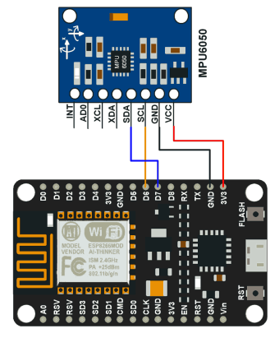
GYROSCOPE → MPU-6050
Specifications
PINS:
VCC
GND
SCL
SDA
XCL
XDA
ADD
INT

Slide 19
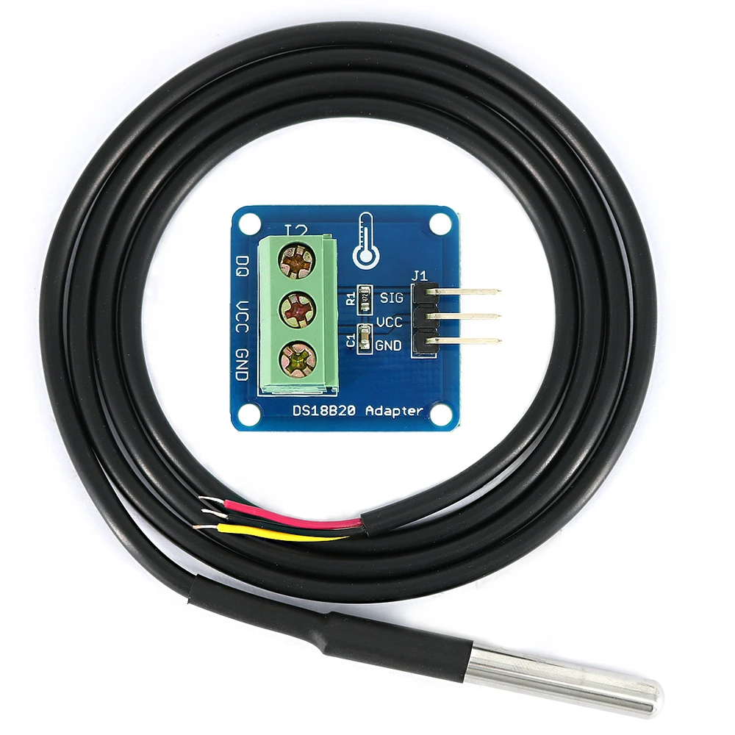
TEMPERATURE → DS18B20
Specifications
1-Wire interface requires only one port pin for communication
Requires no external components
Power supply range is 3.0V to 5.5V
Zero standby power required
Measures temperatures from -55°C to +125°C( -67°F to +257°F)
±0.5°C accuracy from -10°C to +85°C

Slide 20
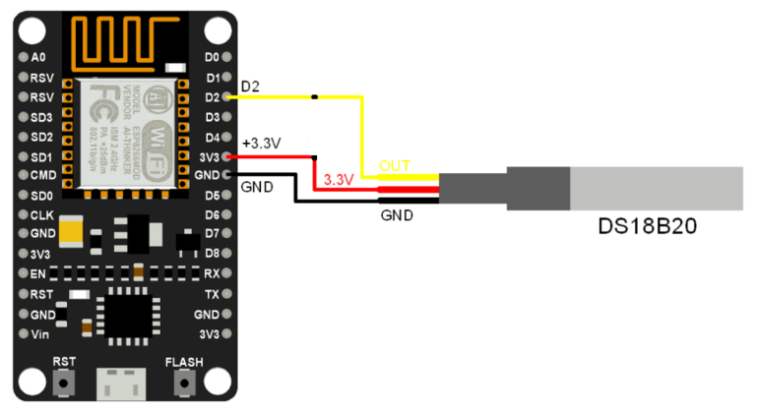
TEMPERATURE → DS18B20
Specifications
VCC
GND
DATA
PINS:

Slide 21
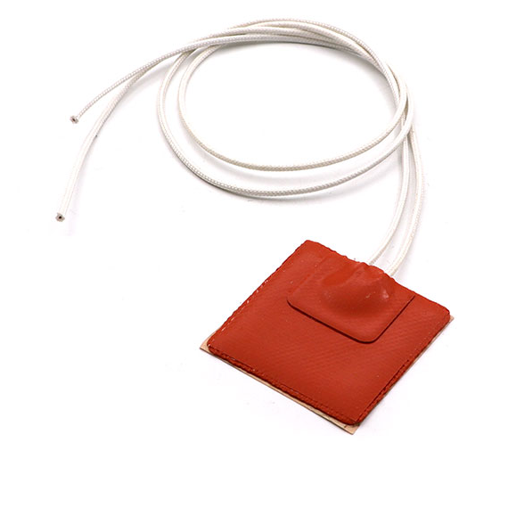
HEATING PADS
Specifications
Material: Silicon Rubber
Dimensions: 5x5cm
Voltage input: 12VDC
Power consumption: 10W

Slide 22
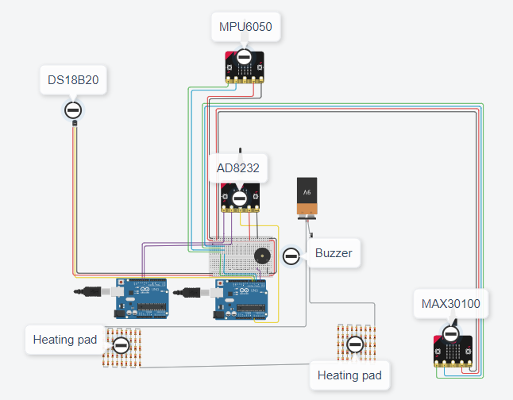
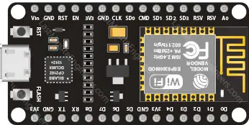
CIRCUIT IMPLEMENTATION

Slide 23
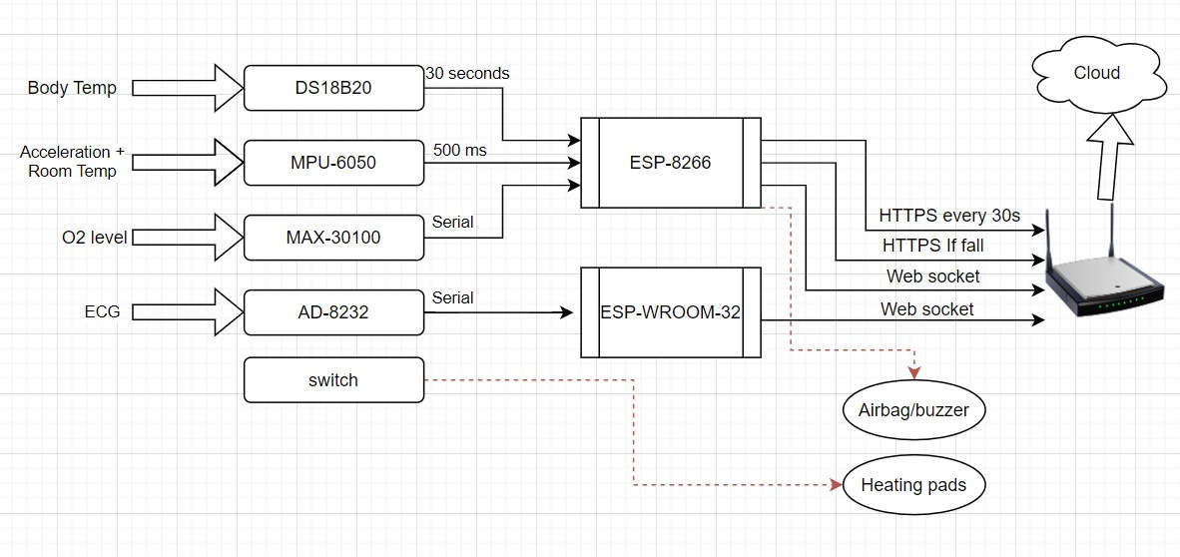
ARDUINO FLOW CHART

Slide 24
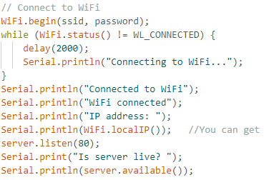
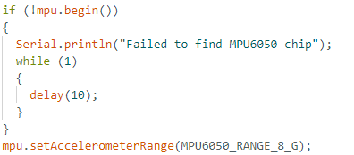
ARDUINO SETUP
Wi-Fi connection:
MPU-Gyroscope:

Slide 25
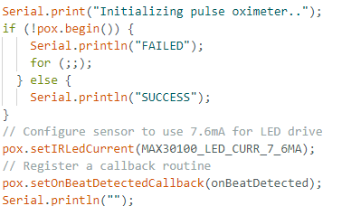
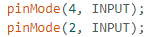
ARDUINO SETUP (2)
MAX-30100 oxygen level:
AD-8232 ECG

Slide 26
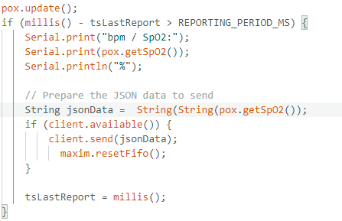
OXYGEN LEVEL MAX-30100

Slide 27
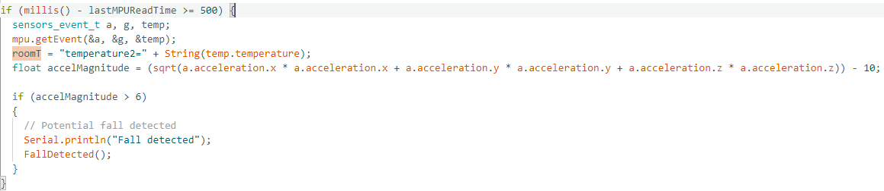
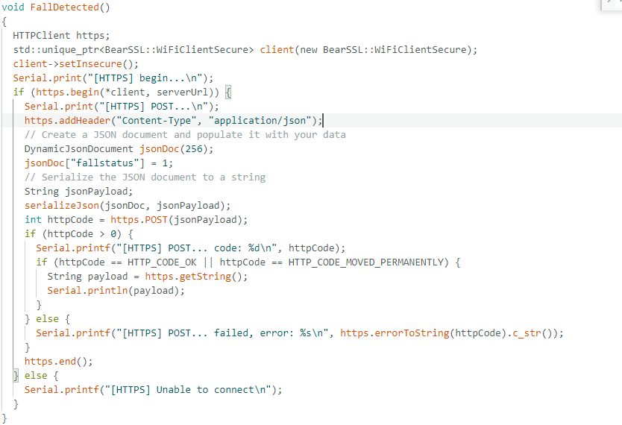
FALL DETECTION MPU-6050

Slide 28
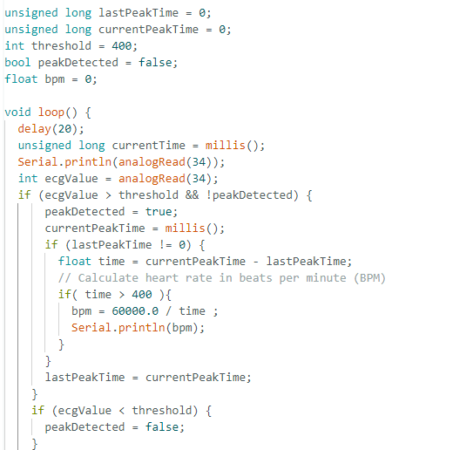
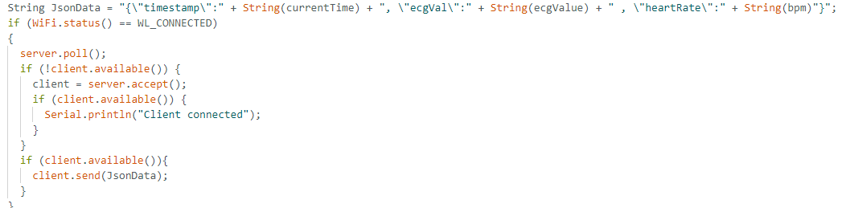
ECG AND HEART RATE AD-8232

Slide 29
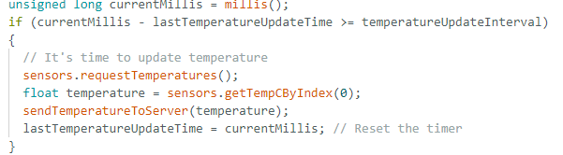
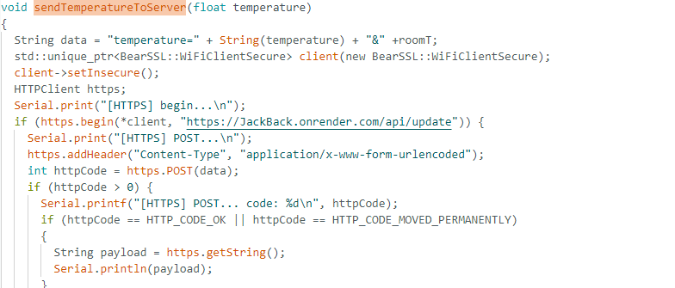
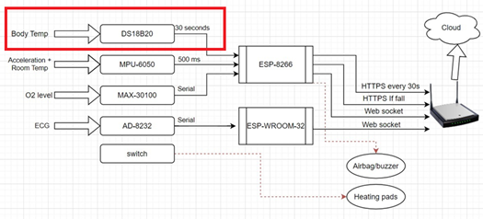
TEMPERATURE SENSOR DS18B20

Slide 30
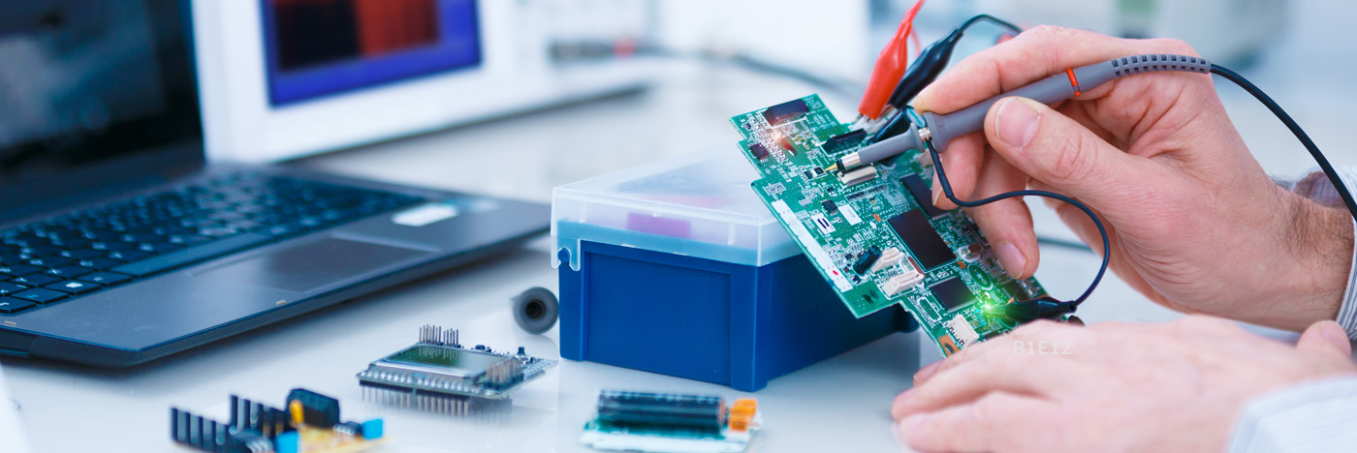
HARDWARE TESTING

Slide 31
FALL DETECTION MPU-6050
Natural Movements
﻿-9.33 0.51 0.88 0.03 0.27 0.28 1.36 0.71 1.46 1.01 1.15
0.76 0.78 0.84 0.72 0.91 0.73 0.81 0.75 0.29 0.82 0.54
0.39 0.69 1.16 0.63 0.63 1.21 0.53 1.61 0.52 1.11 0.64
1.02 0.69 -0.21 1.47 1.29 0.33 -0.16 1.26 1.77 0.92 0.52
1.23 0.35 0.70 0.94 1.02 0.43 0.89 1.18 0.70 1.46 0.68
1.21 1.30 1.12 1.48 -0.17 1.38 -0.02 2.17 -0.11 1.31 0.47
0.58 0.06 0.34 2.36 1.79 0.69 1.60 1.17 1.11 -0.86 0.48
-0.45 1.22 0.93 0.25

Slide 32
FALL DETECTION MPU-6050
Fall Detection with threshold [-2,+2]
0.80 0.86 2.04 Fall detected
0.96 0.05 1.27 1.33 2.11 Fall detected
0.72 0.13 23.85 Fall detected
2.39 Fall detected
0.33 0.45 0.71 2.10 Fall detected
0.62 0.72 0.42 0.83 0.56 1.14 .144 0.53 1.76 1.93
0.47 2.46 Fall detected
0.76 1.47 0.88 0.80 -2.50 Fall detected
0.99 1.28 1.65 -5.27 Fall detected
0.69 -0.62 1.60 -0.13 -2.18 Fall detected
0.10 0.16 0.41 0.42 -3.55 Fall detected 1.11 1.10 1.11 1.01 1.08 1.01 1.15 1.09 0.99 1.13
1.07 9.84 Fall detected
0.78 0.96 1.23

Slide 33
FALL DETECTION MPU-6050
﻿0.39 0.43
0.37 0.41 0.34 0.40 0.41 0.40 0.42 0.43 0.39 0.41 -0.27
-0.47 0.43 0.90 -0.59 30.74 Fall detected
0.11 -0.40 -4.33 Fall detected
-2.07 -1.40 16.54 Fall detected
-0.48 4.90 Fall detected
-0.48 0.04 -1.62 -0.62 -0.50 4.45 Fall detected
-3.56 -1.68 -1.17 0.40 0.29
Fall Detection with threshold [-4,+4]
1.05 0.88 1.21 1.30 0.81 0.07 11.73 Fall detected
0.26 1.93 2.26 -0.74 0.84 1.07 -6.54 Fall detected
1.18 0.79 0.53 0.91 0.50 10.86 Fall detected
1.30 2.13 1.87 1.14 1.76 2.60 1.52 2.56 2.07 -0.22 1.92
3.99 0.96 2.31 2.71 2.81 3.85 1.12 0.85 2.77 1.30 1.36
3.77 0.70 2.08 1.15 7.59 Fall detected
1.17 0.98 1.06 1.70 2.16 0.59 0.61 0.44 9.90 Fall detected 0.06 4.93 -1.20 -0.64 19.29 Fall detected
-6.84 Fall detected
0.64
Fall Detection with threshold [-6,+6]

Slide 34


AIRBAG
1
Fall Detection Delay
500 milliseconds
2
Airbag Delay
50 milliseconds
3
Total Delay
550 milliseconds
Equation
4
$$time= \sqrt{\frac{2h}{g}}=580 milliseconds$$

Slide 35
HEATING PADS
1
Standard temperature
According to Cardinal Health, the appropriate and safe temperature range is 40-45°C.
2
At 9 volts
Temperature is 35.63°C
3
At 12 volts
Temperature is 43.94°C
Equation

Slide 36
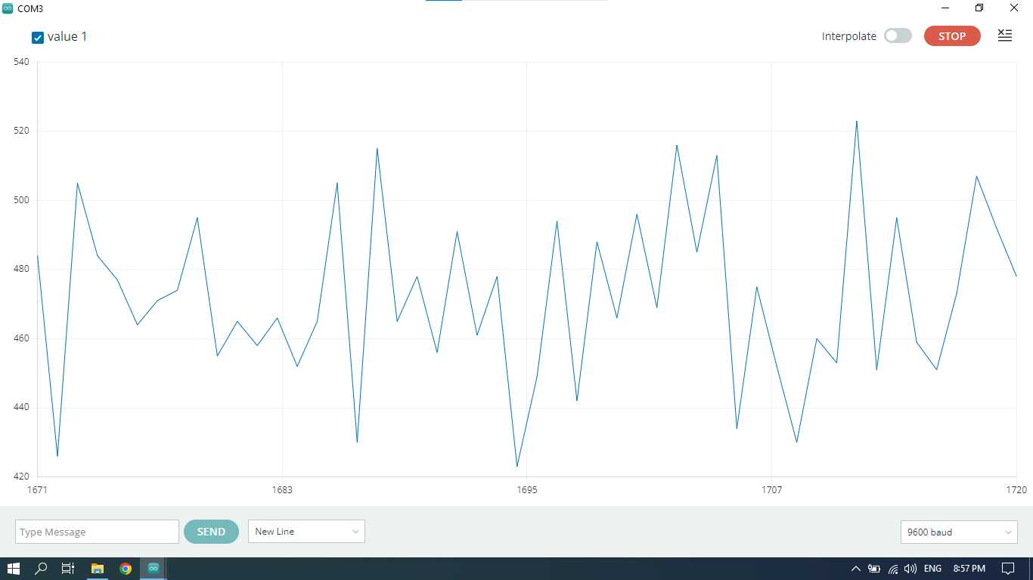
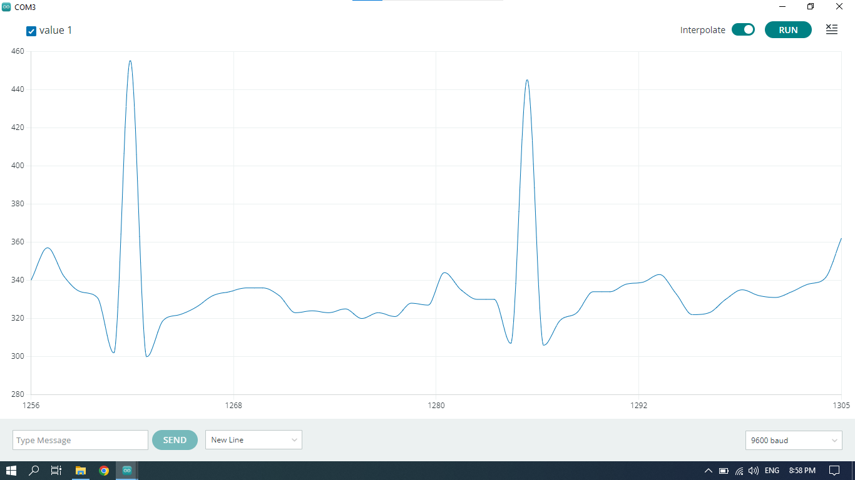
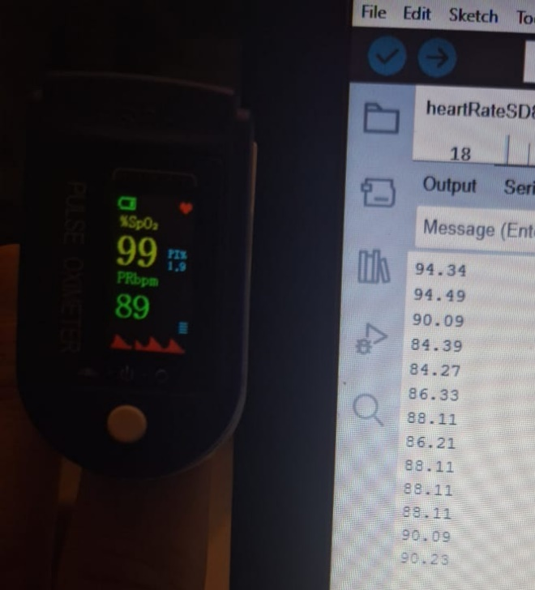
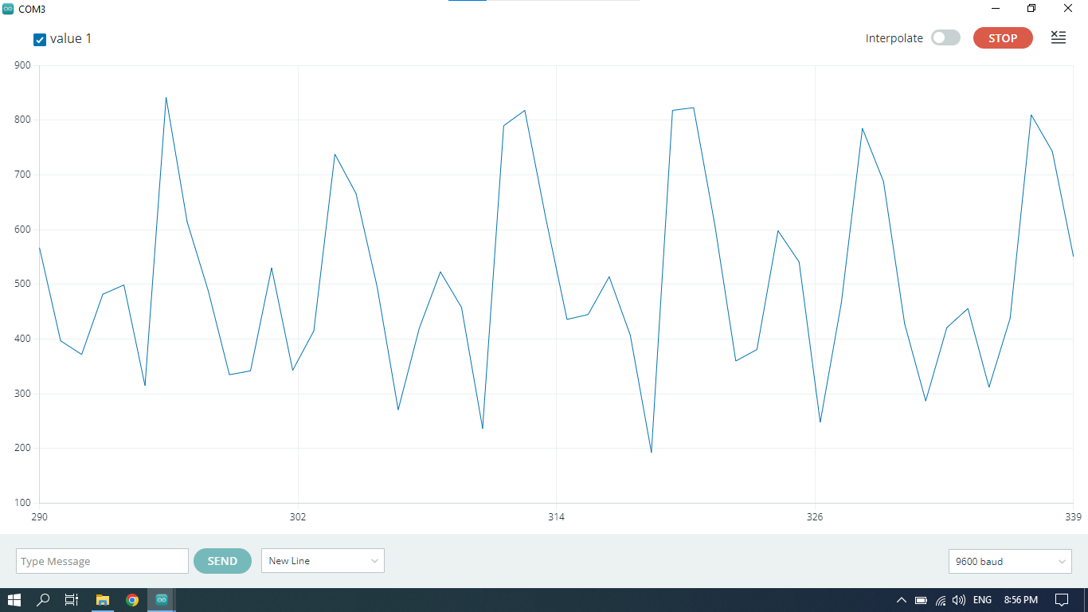
ECG AND HEART RATE AD-8232
1% and up to 8% error

Slide 37
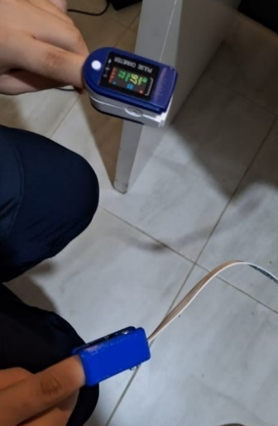
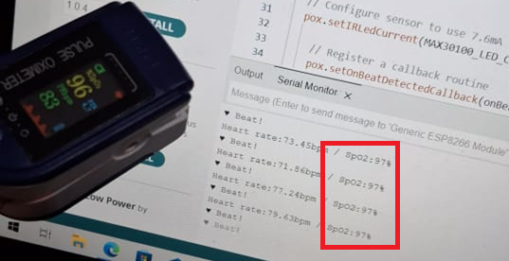
OXYGEN LEVEL MAX-30100
1% error

Slide 38
1
22.4°C
Room temperature is 22.4°C
ROOM TEMPERATURE USING MPU-6050
2
22.18 °C
On MPU-6050 is 22.18 °C
3
1.2%
1.2% error calculated

Slide 39
1
22.4°C
BODY TEMPERATURE USING DS18B20
Body temperature is 22.4°C
2
22.31 °C
On DS18B20 is 22.31 °C
3
0.66%
0.66% error calculated

Slide 40
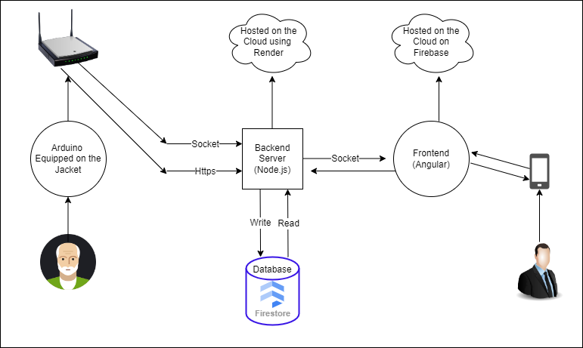
APPLICATION CHART

Slide 41
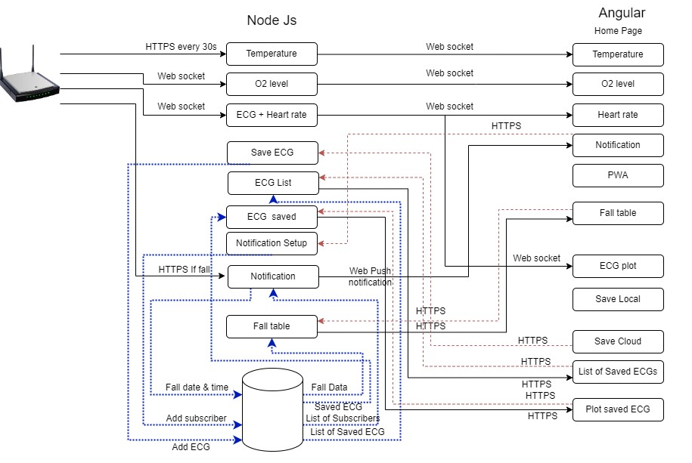
IN DEPTH APPLICATION CHART

Slide 42
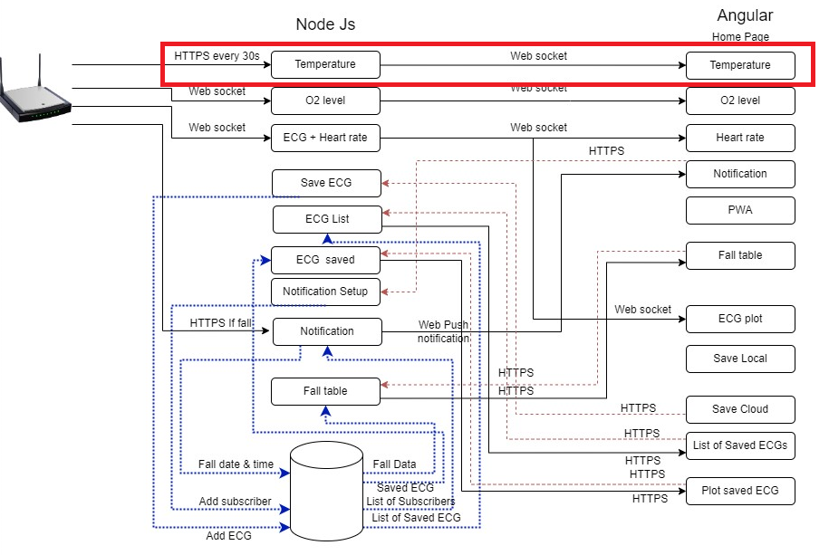
TEMPERATURE

Slide 43
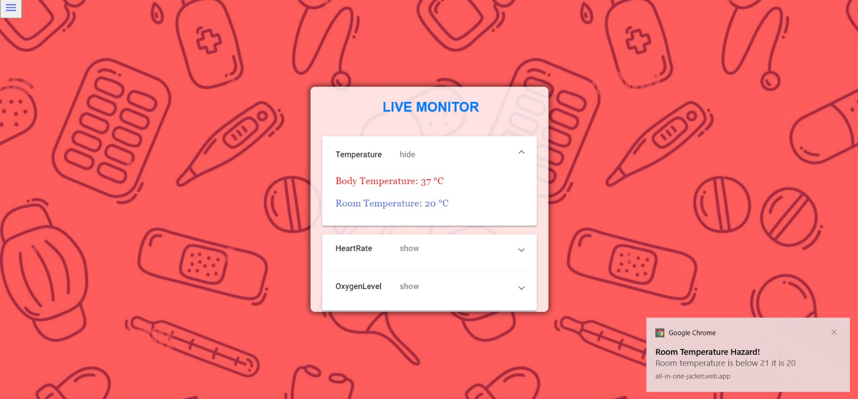
TEMPERATURE

Slide 44
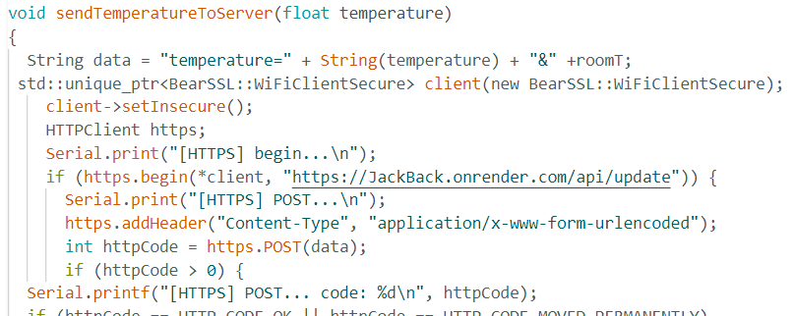
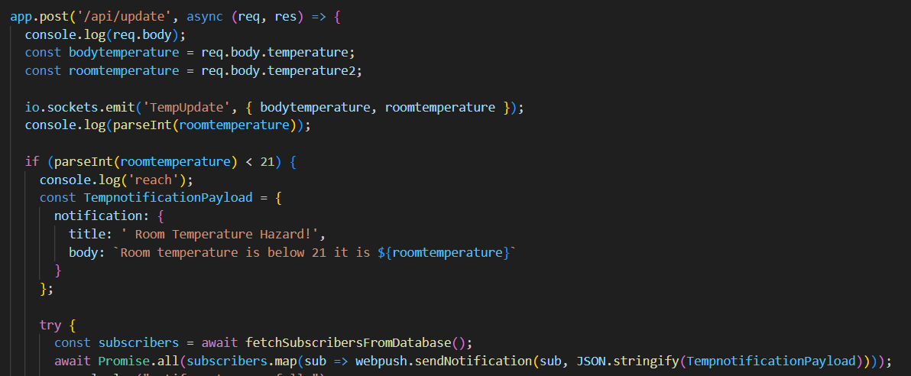
TEMPERATURE
Arduino Side
Node.js Side

Slide 45
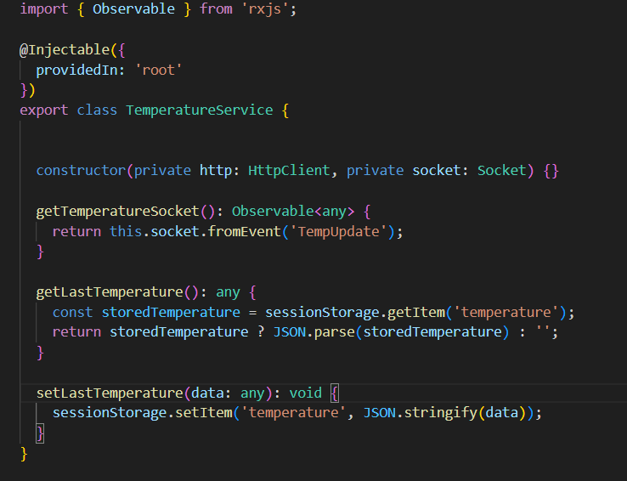
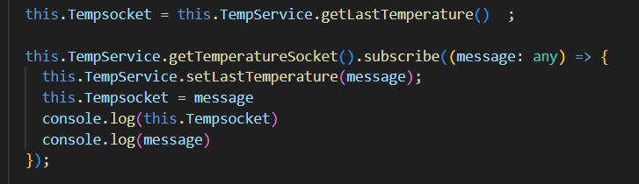
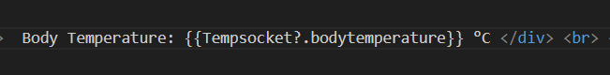
TEMPERATURE
Temperature Service
Subscribe
Home-Page Component
Html Template Data Binding

Slide 46
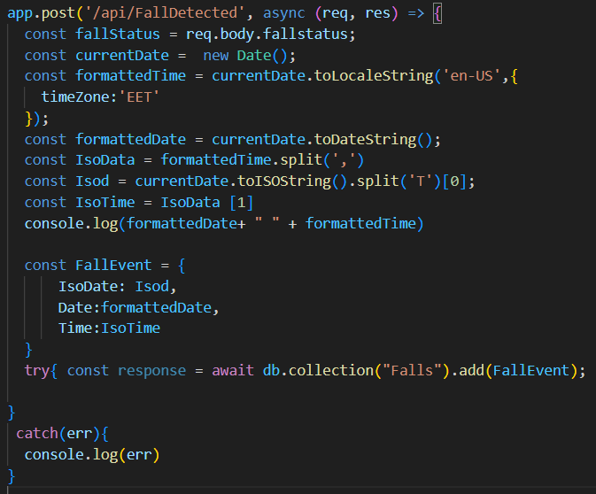



FALL DATA + NOTIFICATION

Slide 47



FALL DATA QUERY

Slide 48


ECG PLOTTING

Slide 49



ECG SAVING

Slide 50




ECG PLOTTING & SAVING

Slide 51


ANGULAR PWA
Modern web technology to make websites feel more like the apps.
Use functionalities that are only for application on a website like notification.
Market of PWA will reach up to 10.77 billion dollars by 2027
Google reports a significant increase of 270% in desktop installations of PWAs from the beginning of 2021.

Slide 52

TO INSTALL THE APP SCAN THE QR CODE

Slide 53
RISK ASSESSMENT USING FMEA
Heart rate device malfunction
2
Airbag malfunction
4
Heater malfunction
1
Oxygen device malfunction
3
Software glitch
5

Slide 54
TYPES OF RATING | HEATER | ECG | OXYGEN | AIRBAG | SOFTWARE
SEVERITY RATINGS | 9 | 6 | 3 | 10 | 7.5
OCCURRENCE RATINGS | 5 | 1 | 1 | 6.5 | 5.5
DETECTION RATINGS | 8 | 8 | 8 | 8 | 6
RPN | 360 | 48 | 48 | 520 | 247.5

Slide 55
COMPONENTS | COST IN DOLLARS
ESP-8266 | $3.50
ESP-WROOM-32 | $7.77
AD-8232 + ELECTRODES | $11.00 + $6.00
MAX-30100 | $7.00
MPU-6050 | $4.00
DS18B20 | $2.00
HEATING PADS | $6.00 * 2
JACKET | $15.00
POWER BANK | $20.00
ADDITIONAL MATERIAL (BREADBOARD, WIRES ETC..) | $20.00
TOTAL COST | $108.27

Slide 56
WORK BREAKDOWN
2.
4.
Application Development
1.
Hardware Development
3.
5.
2.1 Hardware connections
2.2 Hardware coding
4.1.1. Front-end Development
4.1.2 Back-end Development
4.2. Deployment
Project Initiation
Tangible Implementation
Testing
1.1. Collect all items
1.2. Test all collected items
3.1. Design jacket
3.2. Add all components

Slide 57
ACTIVITY | JUL | AUG | SEP | OCT | NOV
GET ALL COMPONENTS NEEDED | ELIE & ATIEH | ELIE & ATIEH
PROGRAM THE HEART RATE |  |  | ELIE
PROGRAM THE OXYGEN SENSOR |  |  | ATIEH
PROGRAM THE TEMPERATURE SENSOR |  |  | ELIE
PROGRAM FALL SENSOR |  |  | ATIEH
DESIGN JACKET |  |  |  | ELIE & ATIEH
ADD ALL COMPONENTS |  |  |  | ELIE & ATIEH
CREATE THE FRONT-END |  |  |  | ELIE & ATIEH
CREATE THE BACK-END |  |  |  | ELIE & ATIEH
DEPLOY ON SERVER |  |  |  |  | ELIE
TEST ALL COMPONENTS |  |  |  |  | ELIE& ATIEH

Slide 58
THANK YOU!
KEEP YOUR ELDERLY SAFE

